Slide 1
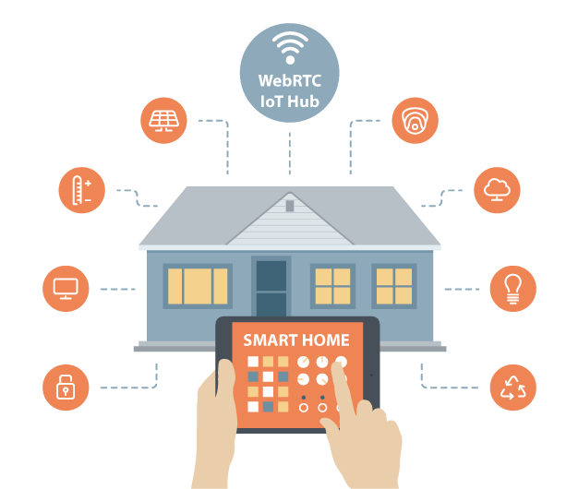

IOT-Home
Presented By:-
Ajay Goel (001897443)
Ankit Yadav (001271369)
Himani Solanki (001899540)

Slide 2
Problem Statement
A Smart Home is one that provides its home owners comfort, security, energy efficiency (low operating costs) and convenience at all times, regardless of whether anyone is home.
We are creating a management system for homes using IOT in which all the necessary task like grocery management, bill payment, parking management, security and maintenance can be completed automatically by making the systems communicate with their respective organizations.
It will enable a better living experience for home owners as well as will be beneficial for other businesses having stakes in the management of home like retailers, security agency, billing teams etc.

Slide 3
2. Application Key Functionalities:
Login/Register page of the IOT Smart Home application
Account ID verification of various utilities like electricity, setting values for groceries etc.
Work Queue Screen
Status Screen
Transaction History Screen
Smart Wallet

Slide 4
3. Proposed Entities:
Enterprise:
Government Enterprise : Water and Electricity Organization.
Security Enterprise: Security Organization
Market Enterprise : Grocery, Retailer, Delivery Organisation.
Society Enterprise : Maintenance, Parking, Garbage and Event Management Organisation.

Slide 5
4. Proposed Entities:
Organisation Roles:
Admin Role
Customer Role
Society Level : Society admin, garbage manager, event manager, maintenance manager roles, employees.
Government Level : Water, electricity and government admin roles.
Grocery Level: Retailer, delivery, grocery admin roles and employees.

Slide 6
Object Model

Slide 7
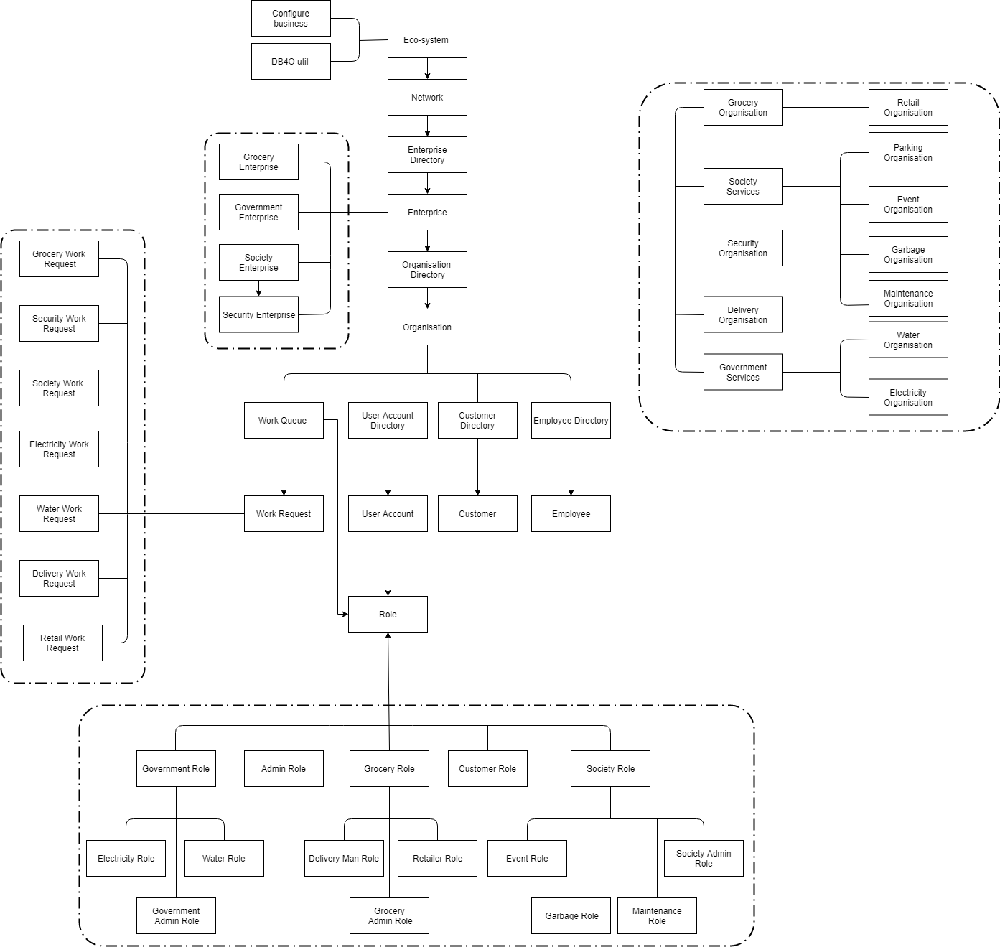

Slide 8
5. Additional Features:
The customer gets an email notification when the products are been delivered
The money transactions are recorded in the wallet statement
Any changes in work request are shown as notification to the customer
The customer can book the nearest parking spot with the help of google maps
The customer can chat with the event organiser in the chat box of the particular event

Slide 9
Screenshots

Slide 10
The Market Enterprise
Retailer Department

Slide 11
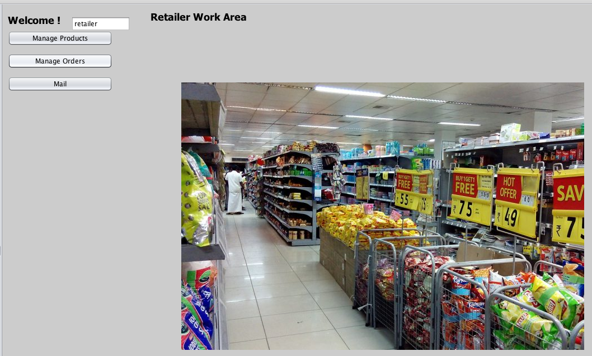
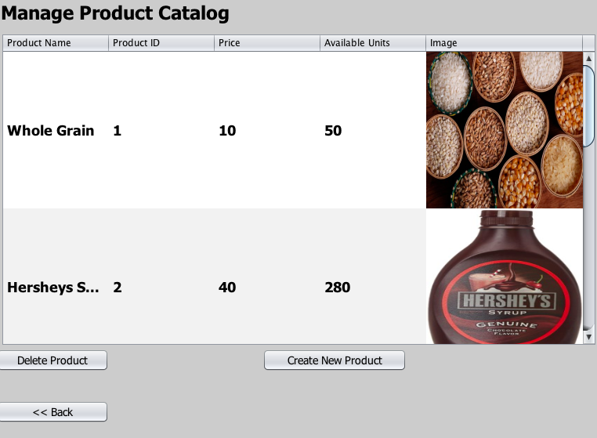
Retailer Work Area: All the products will be managed by the retailer.
Manage Products will help in creating and deleting the products from the retailer product catalog.
Creation of product by clicking on Create new product.
Delete product will delete the selected product from the catalog.

Slide 12
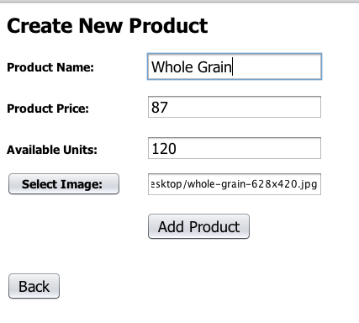
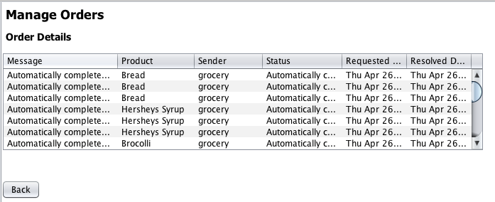
These are the requests which are automatically processed by retailer if the Grocery product goes low than the threshold limit.
All the details of products with the image will be stored by clicking on the Add Product Button

Slide 13
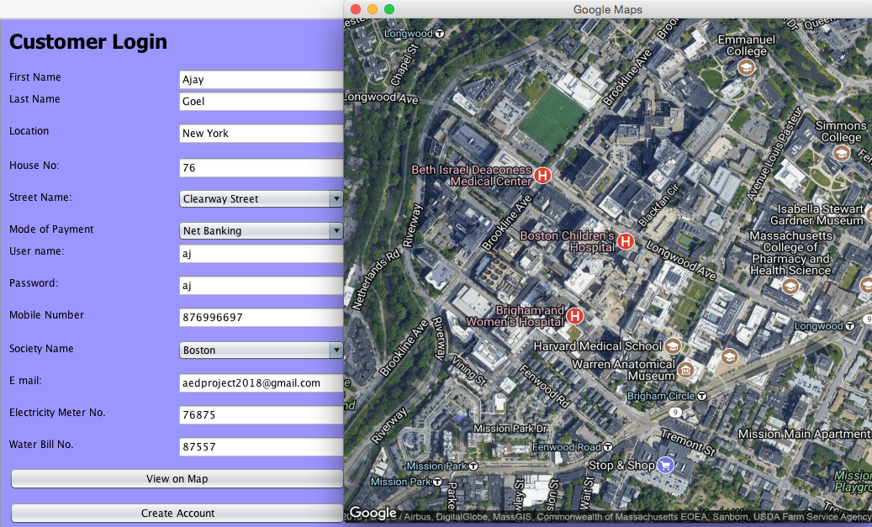
Maps will give the customer
an idea if the area is correct
or not.
Electricity Meter No.,Water No.
are stored in this panel as this
Generate the bill requests for
customer.
Customer will Login: All the details related to location, society user id, passwords will be stored which be helpful for our application to track all the details.

Slide 14
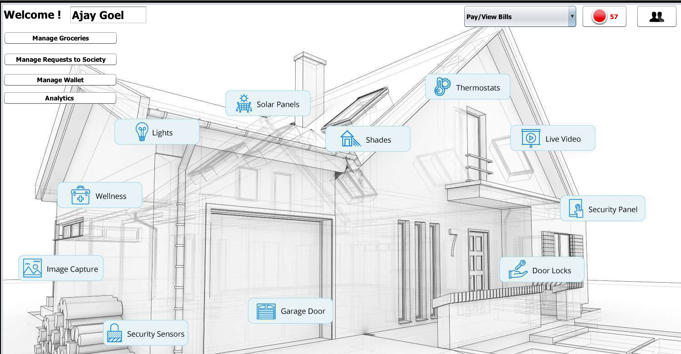
All the work requests related to groceries will be managed.
Society related work requests will be managed from here.
Electricity & Water Bill Req.
Notifications
Manage Accounts
Customer can load and see transactions of the wallet from here.
Analytics will help customer to analyze various scenarios related to W.Requests and Products.
Customer Login Page:

Slide 15
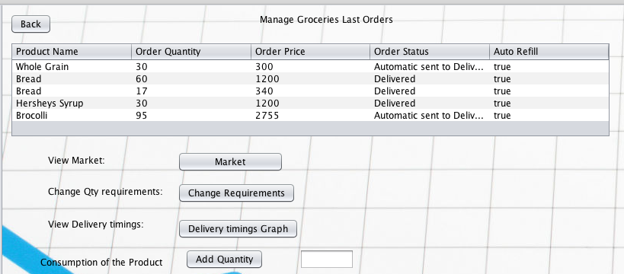
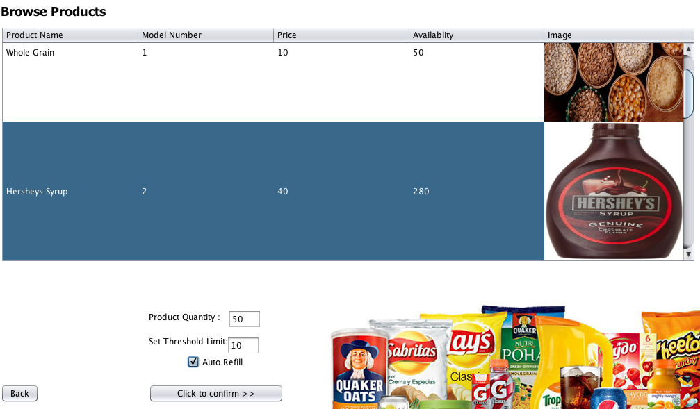
Customer Grocery Panel:
View Market will show the products created by the retailer.
Customer will choose the product, quantity, threshold limit and auto refill checkbox depending on the requirement.
Threshold limit: The product will automatically ordered from the market if the quantity reaches the limit.

Slide 16
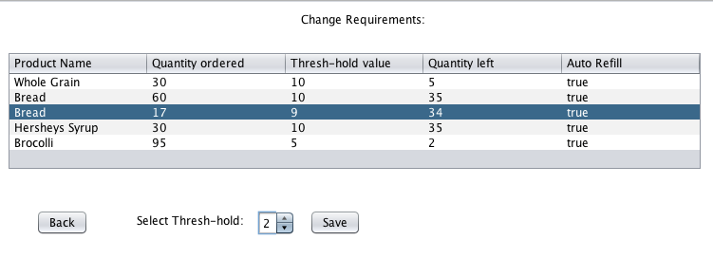
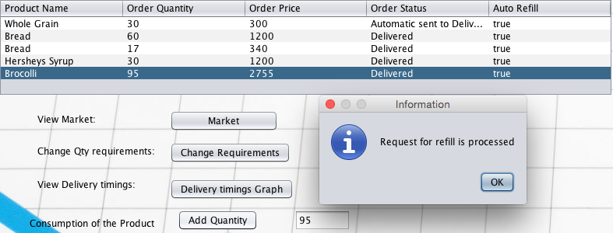
Customer can change the threshold limit according to the requirement.
Customer will select the product and add consumption of the product.
If the product Auto Refill if true and it has reached the threshold limit then request for auto refill be generated automatically and will be sent to the grocery.

Slide 17
2. Grocery Department

Slide 18
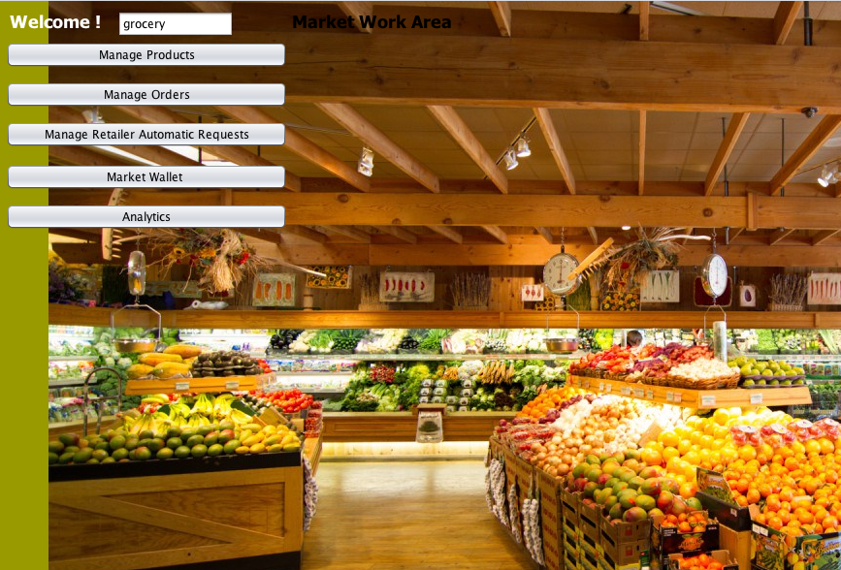
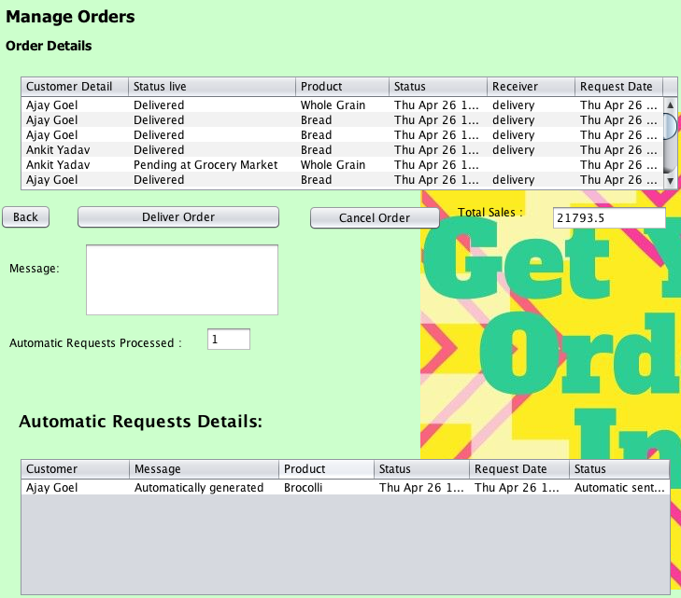
Grocery Work Area: Manage Products will allow the grocery to access the products available in the market.
All the orders, manual and automatic will be shown here:
Manual Requests will be added at delivery side if Deliver Order button is clicked.
Cancel order will cancel the product and refund will be credited back to customers wallet.
Total sales will give the total sales generated from the order.
If the order is added to delivered button then 10% of the price will be credited to the delivery organisation wallet.
Automatic Requests details will be shown in the 2 table: No, button is used as it will be processed automatically.
The Automatic requests processed will give a number of how many requests are processed when the admin has login.

Slide 19
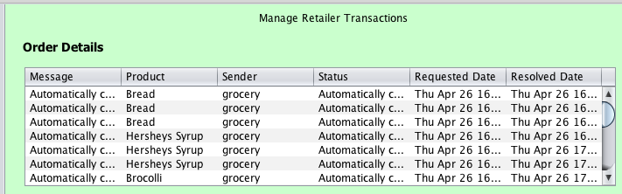
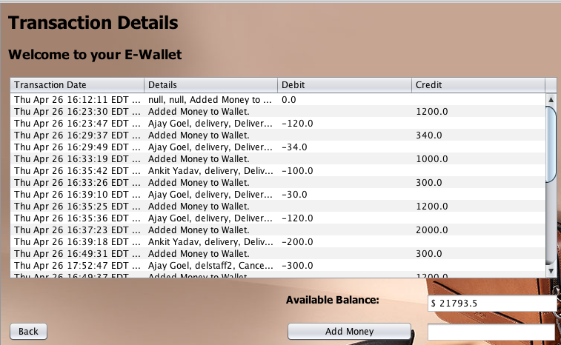
Manage Retailer Transactions:
When the customer orders something, quantity from the product is subtracted from the original quantity.
If the market product reached the threshold qty of 5, then automatically a request is generated which is sent to the retailer.
Retailer will login and again it is completed automatically. For instance, 70 products qty will be added to the availability of the given product.
Grocery Wallet:
Each customer transaction will deposit money to the grocery market, and 10% of the given amount is credited to the delivery organisation from the grocery wallet.
Organisation can also add money in the wallet.

Slide 20
3. Delivery Department

Slide 21
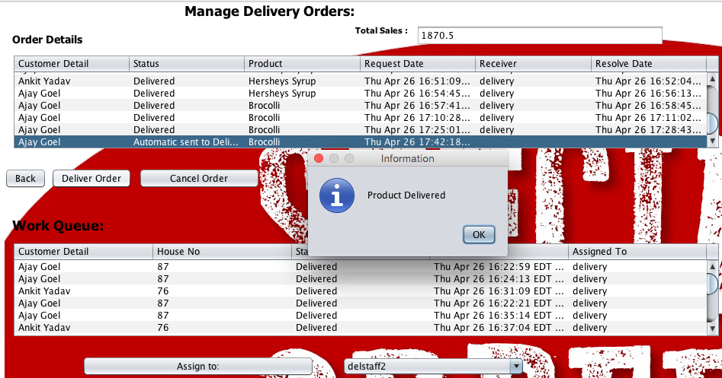
This will show all the orders which are both automatic and manual.
Deliver order after selecting a row will deliver the product to the customer and a mail will be sent to the customer that the product is delivered with the delivery time.
Cancel order will cancel the order and a mail will be sent to the customer that the product has been cancelled.
The Delivery admin can also assign the work request to the staff of Delivery.

Slide 22
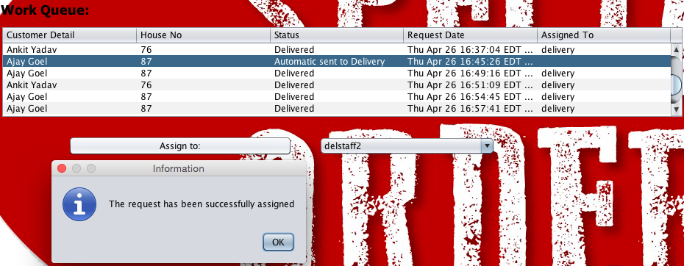
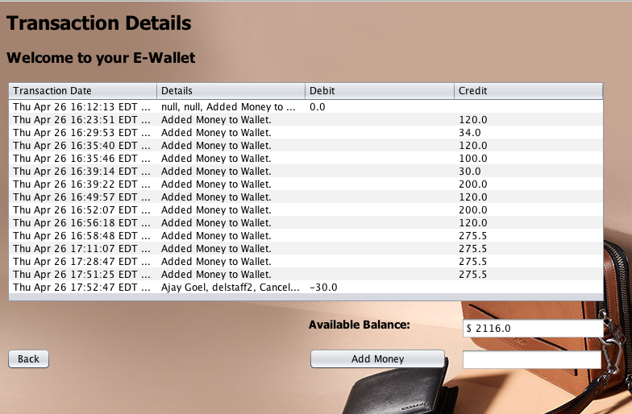
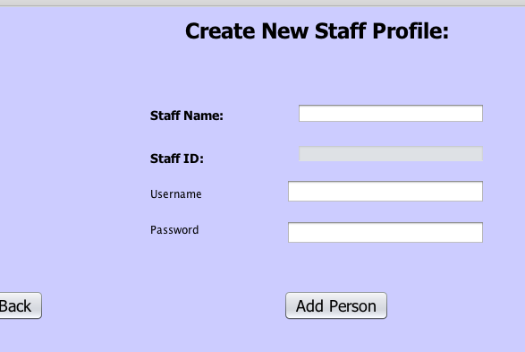
The Work Requests can be assigned to the staff.
Creation of staff through Manage Account
Panel.
Wallet of the delivery organisation.

Slide 23
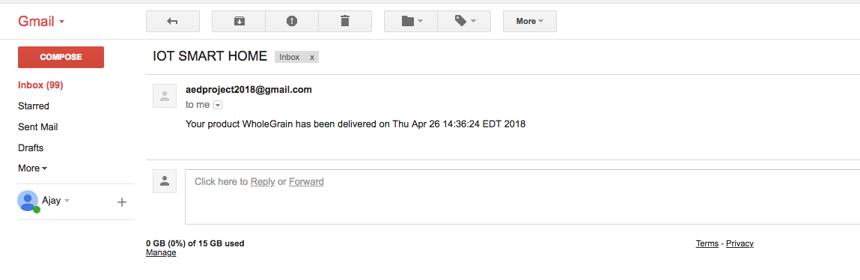
email Notification:

Slide 24
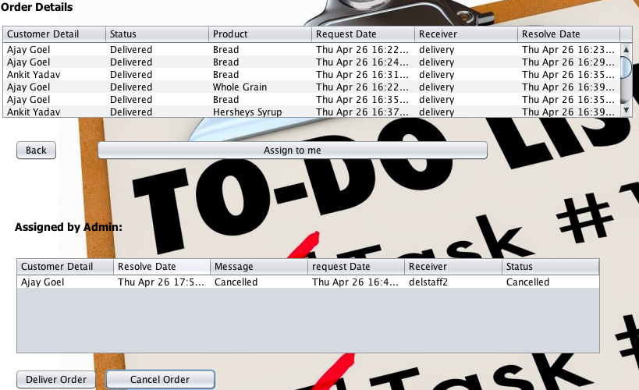
Delivery staff will login and can see all as well assigned work requests.
Staff can assign the request to himself and then deliver or cancel it.

Slide 25
Government Enterprise

Slide 26
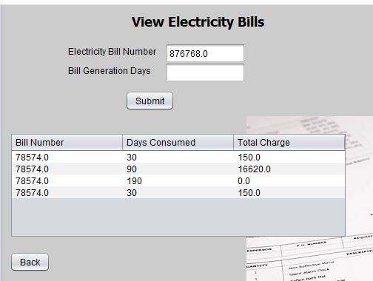
The customer adds the bill generation days and after the bills are generated they are seen here

Slide 27
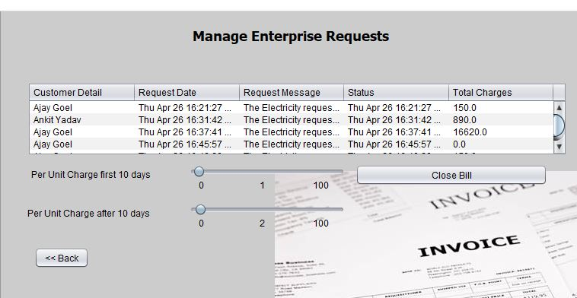
The work request panel for electricity organisation. Here the admin can set the price of the per day electricity consumption

Slide 28
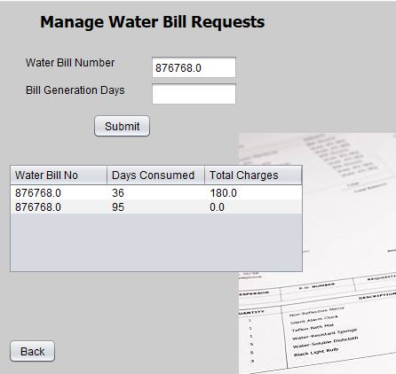
The customer adds the bill generation days and after the bills are generated they are seen here

Slide 29
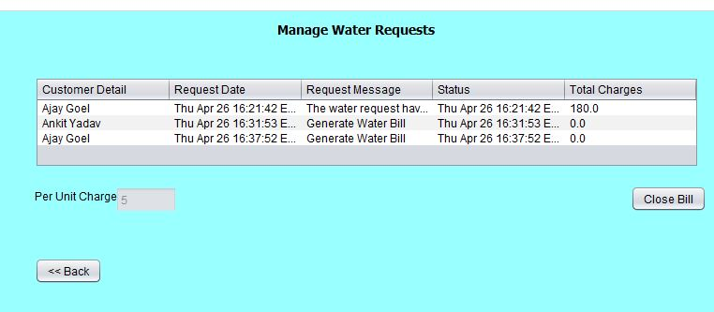
The work request panel for water organisation

Slide 30
Society Enterprise

Slide 31
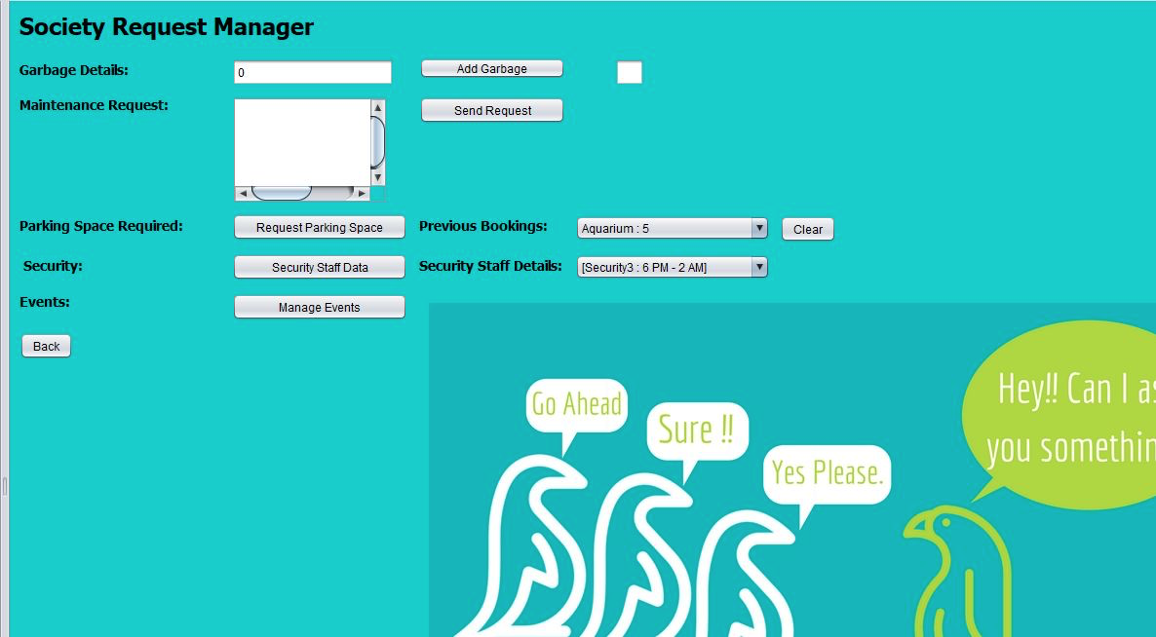
Customer will use society manager to manage all the request from/to society

Slide 32
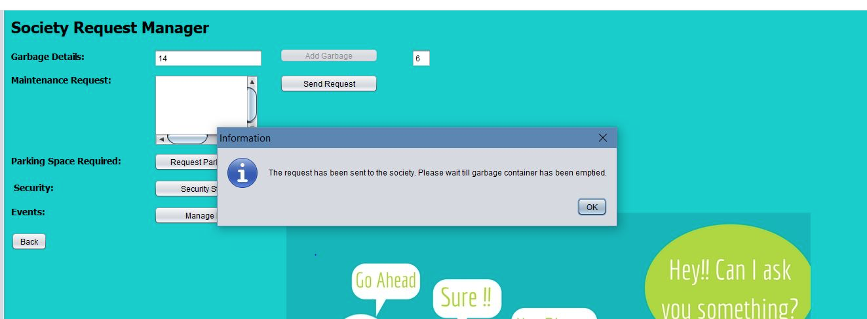
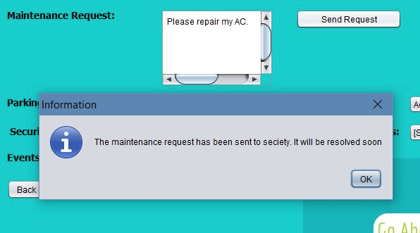
Once garbage bin is full, request will be automatically sent to garbage organization.
Customer will sent maintenance request using message box and same will be sent to maintenance team.

Slide 33
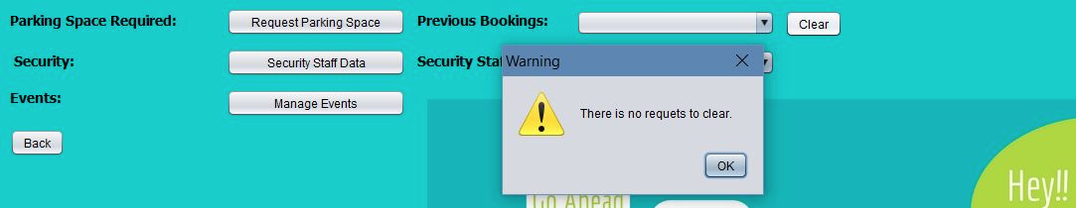
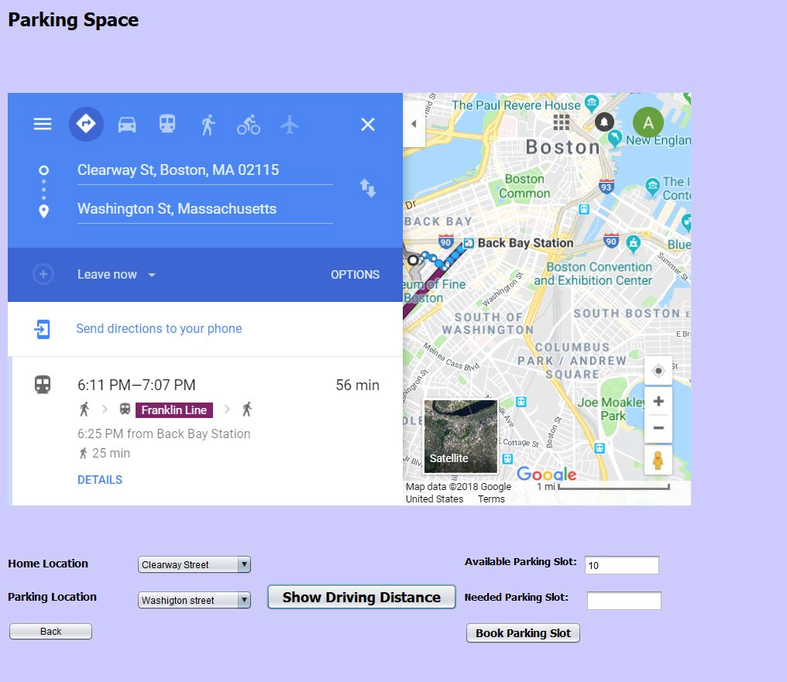
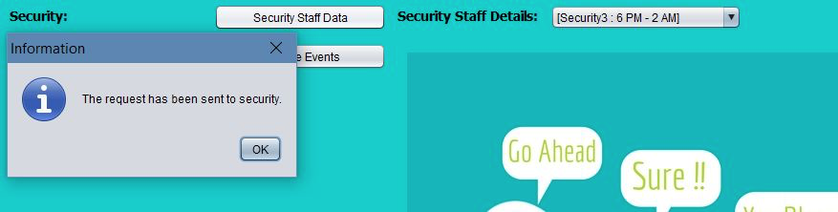
Customer will request for parking space from this panel. He can chose nearest parking
Additionally to know security personnel detail customer will use this tab.

Slide 34
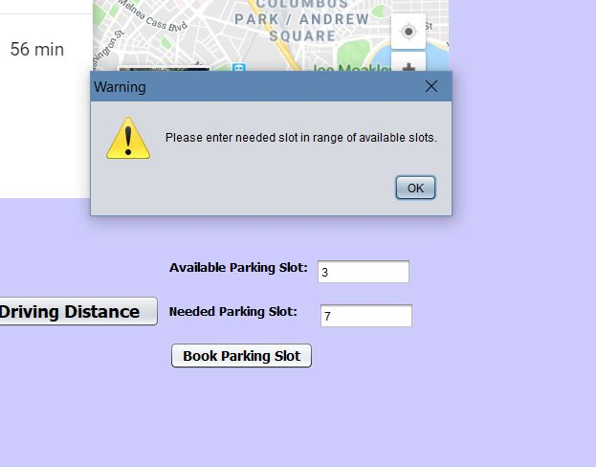
Once selected customer can book the required seats which should not be greater than available seats.

Slide 35
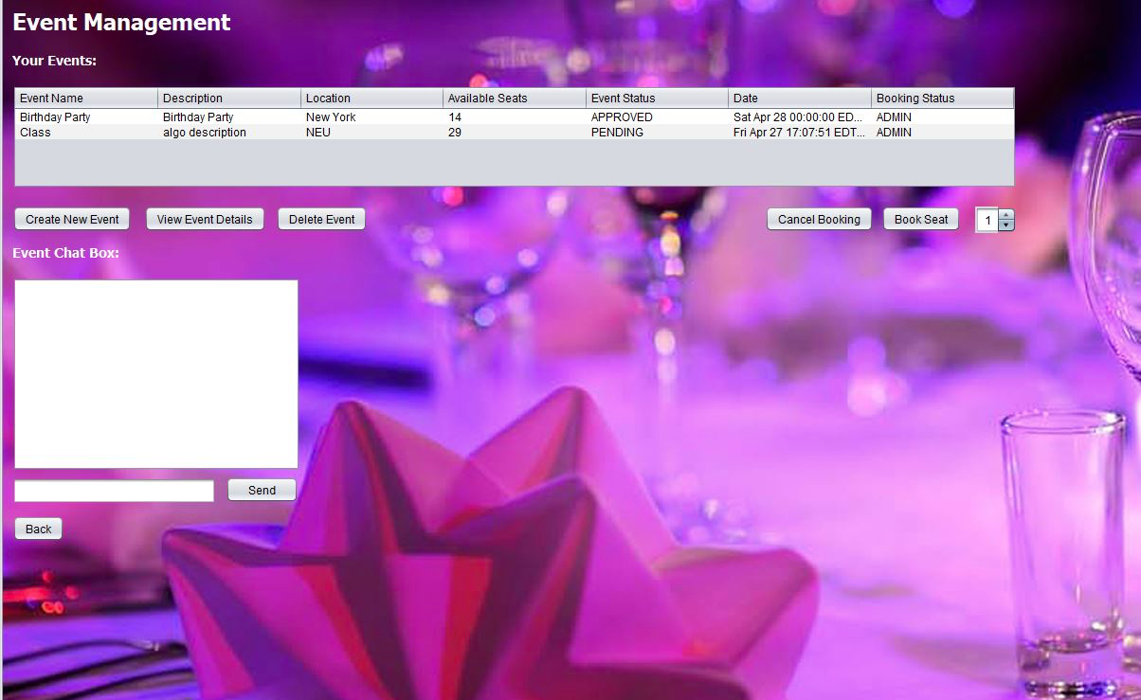
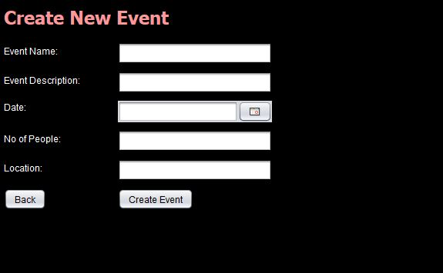
User can view all the events available, booked by him or created by him.
Customer can create new event.

Slide 36
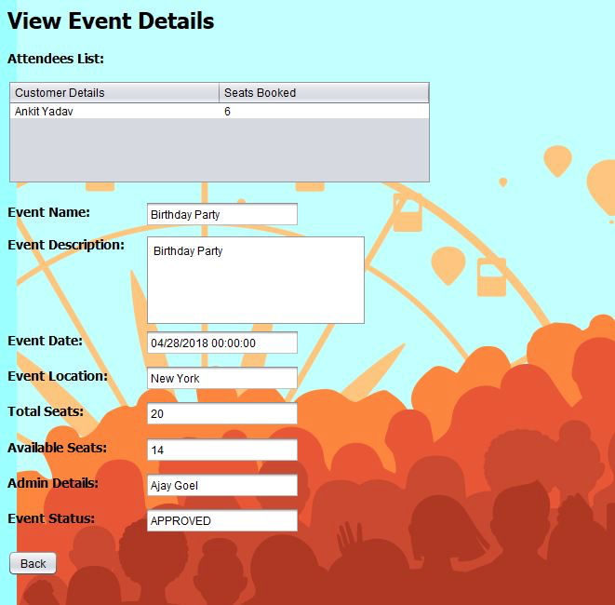
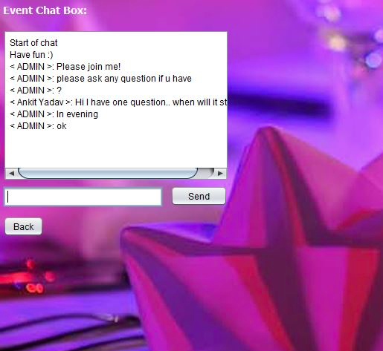
Here user can get details about an event.
Chat Box: To let attendees of a particular event to interact with each other and get necessary informations.

Slide 37
Maintenance Department

Slide 38
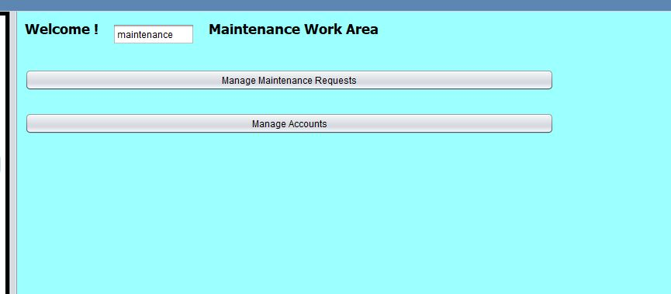
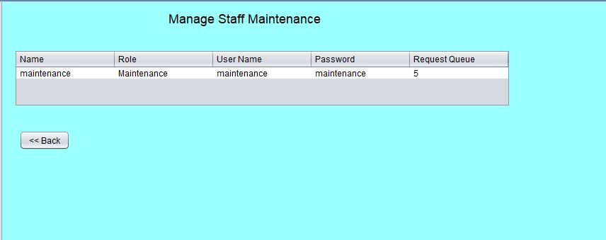
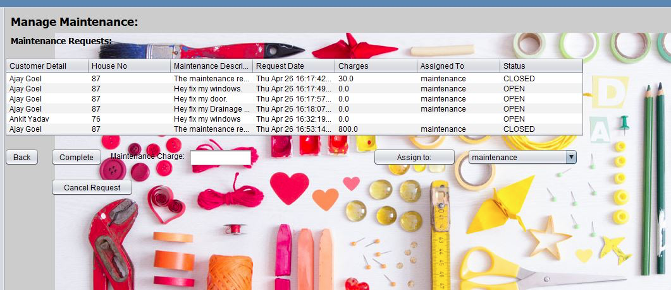
Maintenance organization panels to manage staff requests, resolve a requests and assign requests.

Slide 39
The Garbage Department

Slide 40
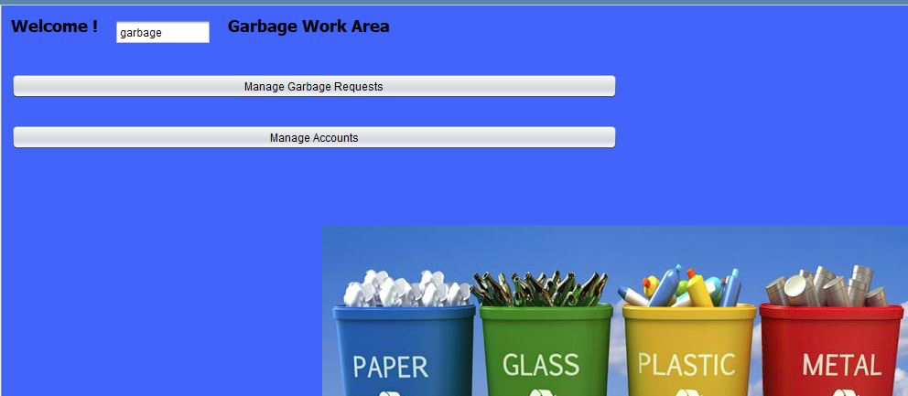
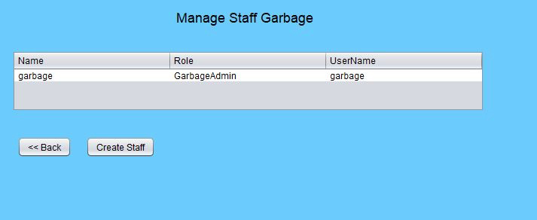
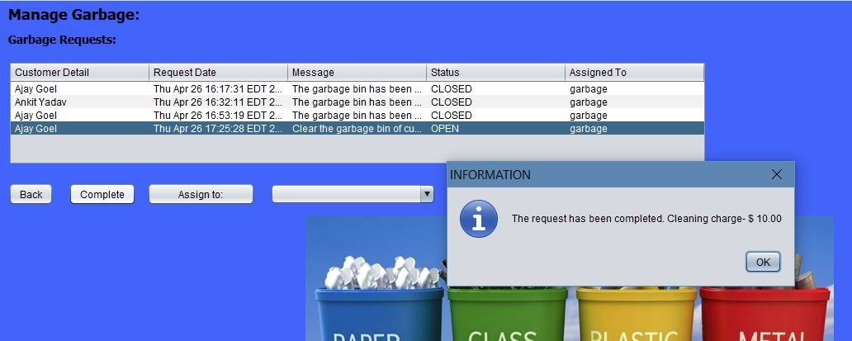
Garbage organization panels to manage staff requests, resolve a requests and assign requests.

Slide 41
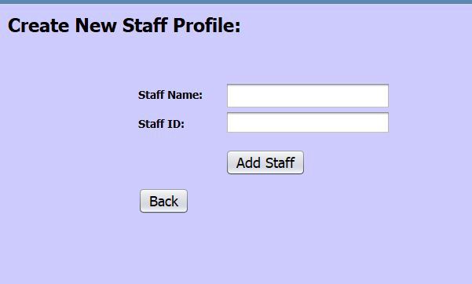
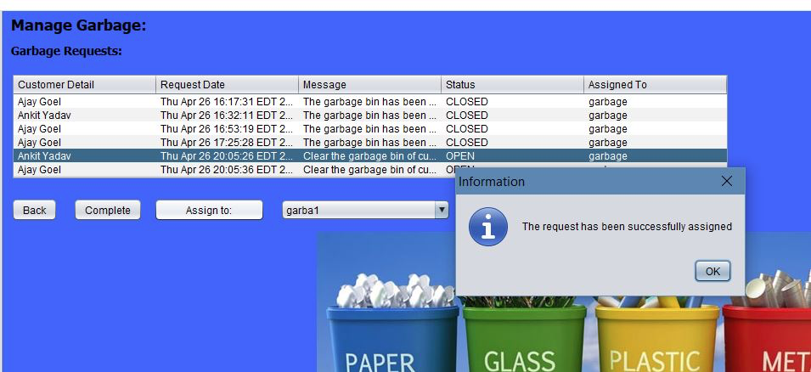
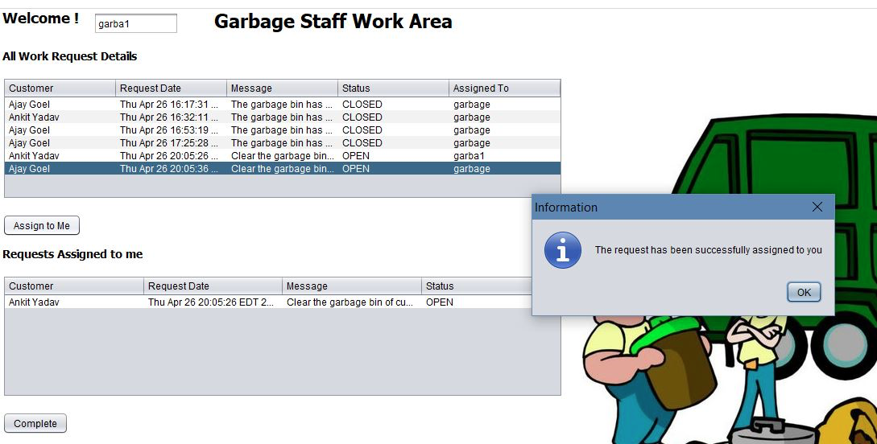
Garbage organization Staff work area. To complete, assign and view request.

Slide 42
Parking Department

Slide 43
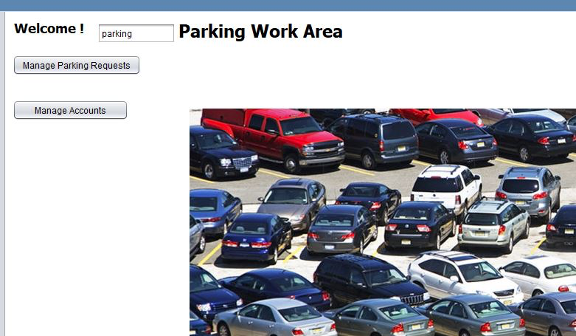
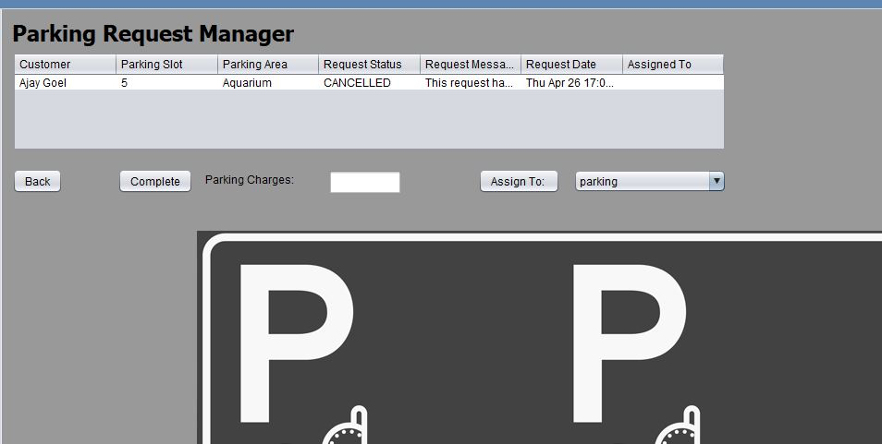
Parking organization panels to manage staff requests, resolve a requests and assign requests.

Slide 44
Event Management
Department

Slide 45
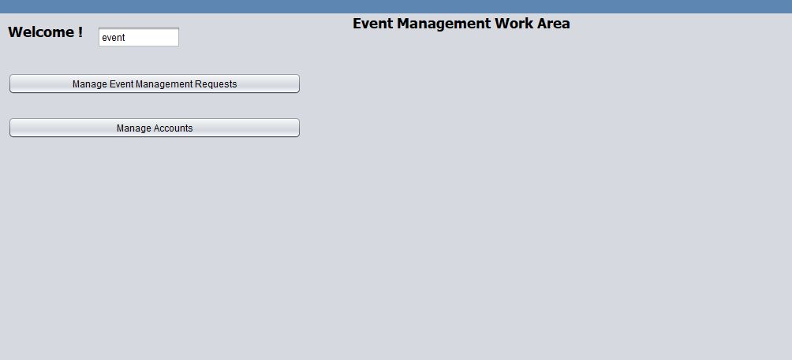
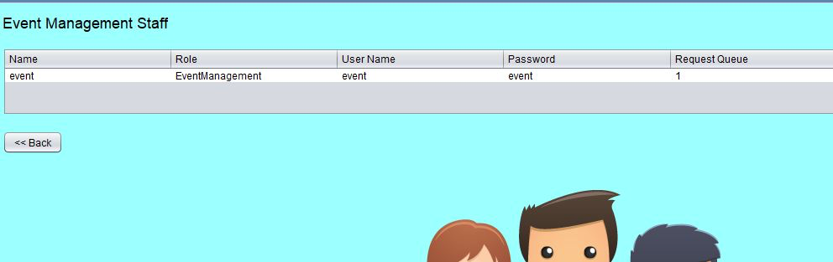

Maintenance organization panels to manage staff requests, resolve a requests and assign requests.

Slide 46
The Security Enterprise

Slide 47


Inter Enterprise communication: Society enterprise will send request to security enterprise and then security enterprise will assign the request to security organization admin for resolution.

Slide 48






Slide 49
Analytics
Customer

Slide 50



Request Status vs Numbers
Open Vs Closed Requests
Products vs Requests Types

Slide 51



Req. No vs
Products
Days vs
Electricity
cost
Time vs Money Transaction

Slide 52


Request Numbers vs Request Types
Quantity vs Time

Slide 53
Analytics
2. Grocery

Slide 54



Request No.
Vs Products
Customer vs Requests
Request Types
Vs
Request Names

Slide 55


Retailer vs Products automatically ordered
Time vs Money

Slide 56



At Last, in case you Missed…
This is customer account and notification panels reached by clicking dark user button and read button respectively
We made it in form of buttons, with number of unread notification displayed beside it just like our BlackBoard !(With mouse hover functionality)

Slide 57
Thank you!!

